Slide 1
Online Cake Shop
Miss : Wavare Shravani Avinash
Miss : Dangre Bhakti Vilas

Slide 2
Introduction
The Online Cake Order project is for customers to order cakes through online for home delivery or pick up from shop.
This project developed using PHP and all the record stores in MySQL database.
This system not only improves customer’s experience but also eases the workload on the staff of cake shop.
As the internet users are increasing exponentially.

Slide 3
Objectives of system
•Build up an online bakery which is rarely exist.
•Ease people lives to make their own cake
•Save people’s time and efforts
•building a broad and committed customer base and developing a business model that brings in enough income to cover your expenses despite a potentially high level of waste.
•The cake ordering system the consume less amount of time.

Slide 4
Functional Requirements
• The interface is equipped with self explantory software.
•User friendly types menus and option Are included in the app.
•The architecture of the product must be researched by the manufacturer.
•The Program kit needs to be installed.
• Both data entered would be contained in sql.
Technology Offers alert to client for the help they needs .

Slide 5
Non functional Requirements
•Good memory space is required.
•It's meant to be error free.
•Huge volume of data can be treated quickly.
•Backup should be performed daily.
•Your password is given To the sql server .
•You can Run this program on every windows Operating system.
•Machine complete all takes in less time.

Slide 6
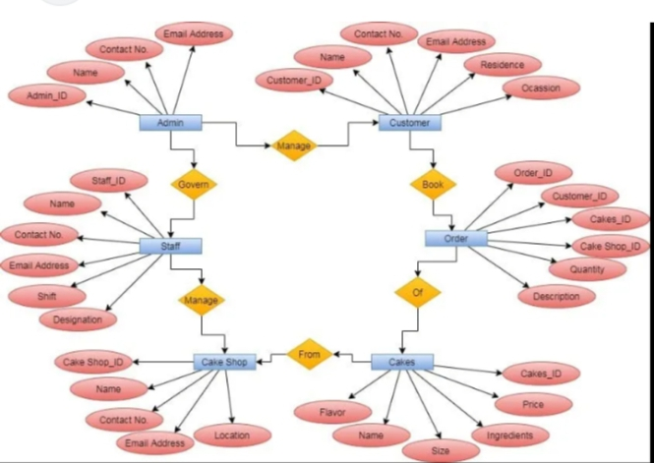

Slide 7
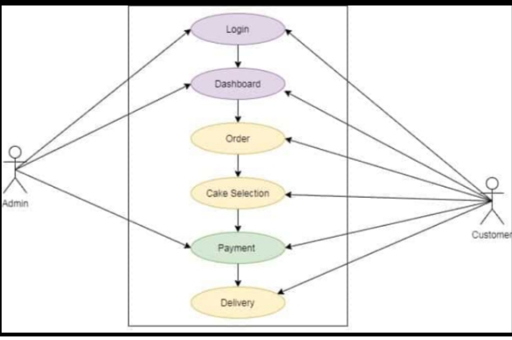

Slide 8
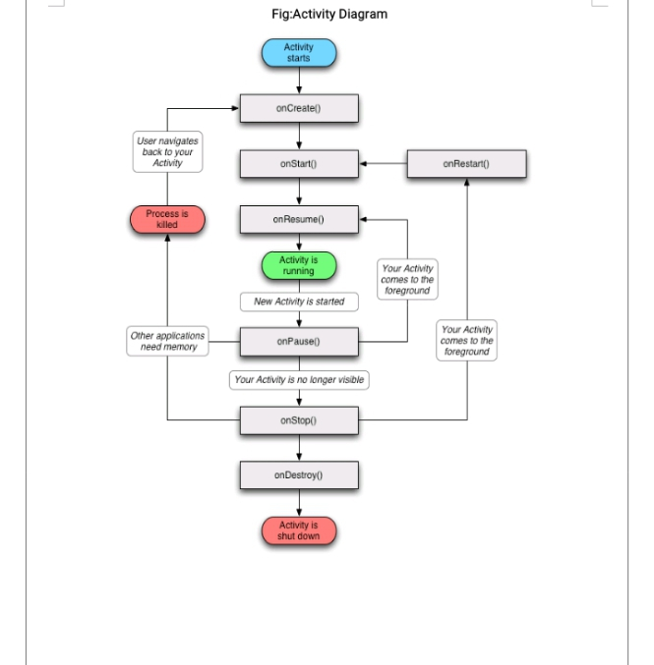

Slide 9
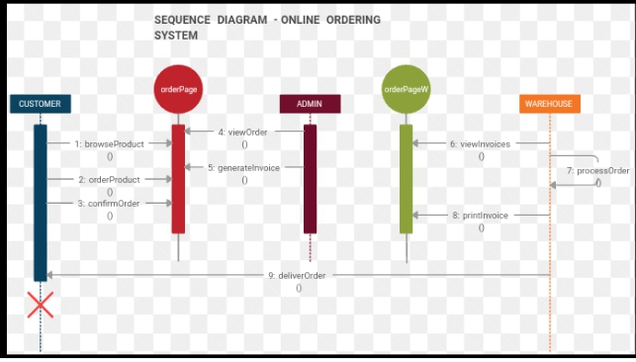

Slide 10
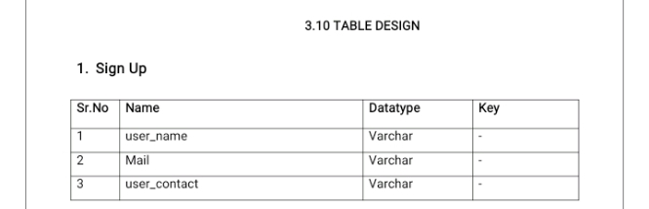

Slide 11
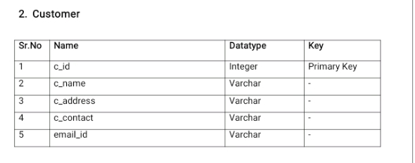

Slide 12
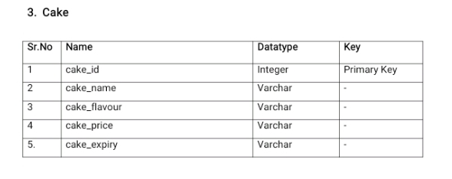

Slide 13
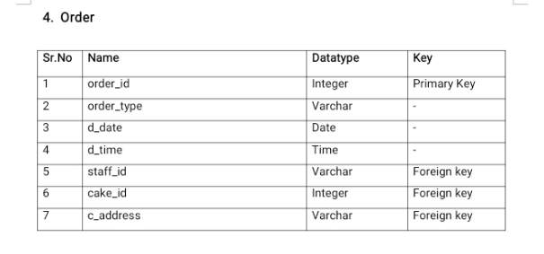

Slide 14
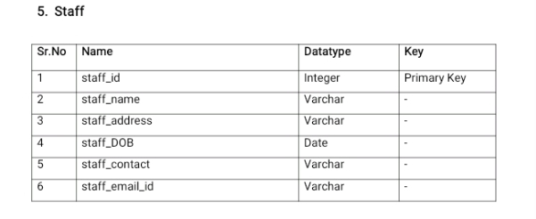

Slide 15
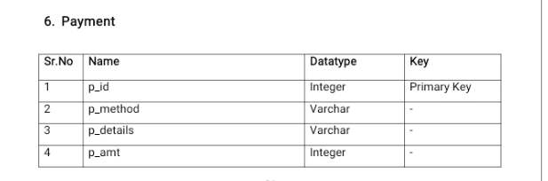

Slide 16
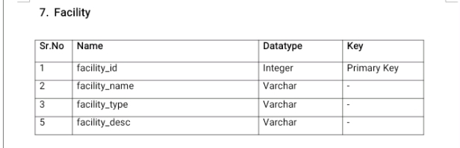

Slide 17
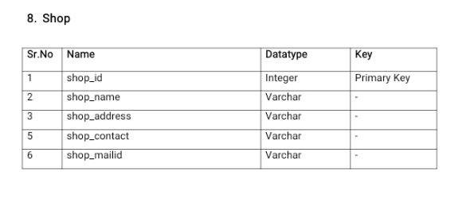

Slide 18
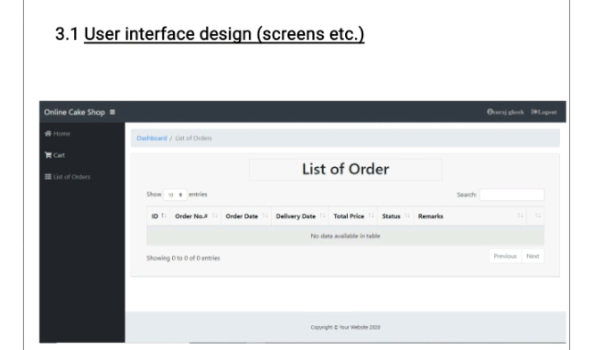
Screenshots

Slide 19
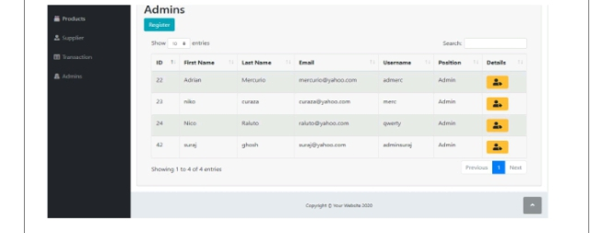

Slide 20
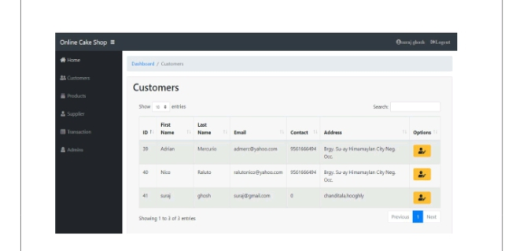

Slide 21
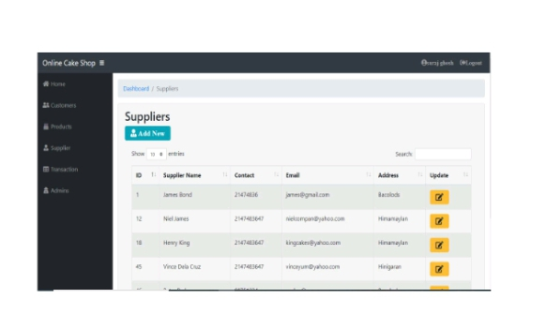

Slide 22
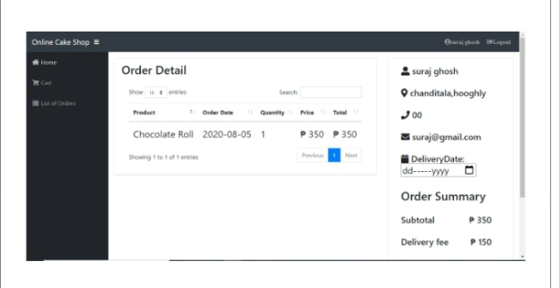

Slide 23
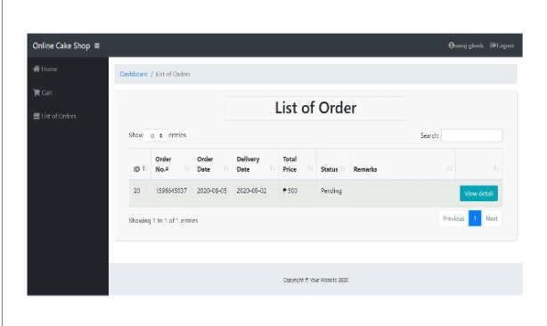

Slide 24
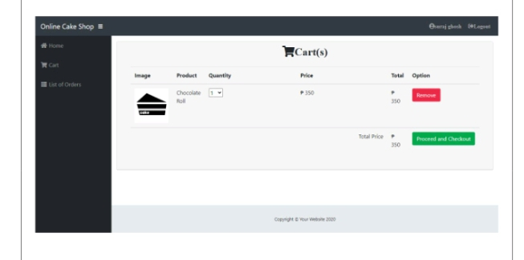

Slide 25
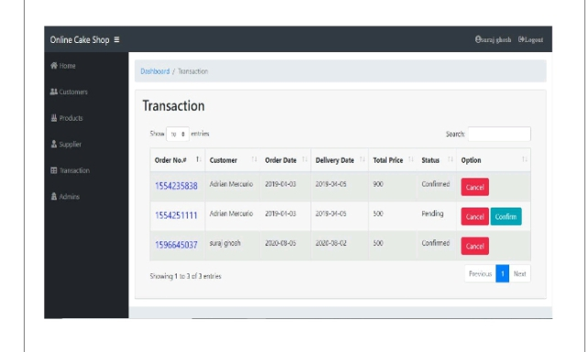

Slide 26
